Slide 1

Starter Task
Complete the SDD implementation starter task
Attempt both questions

Slide 2
Learning intentions and success criteria
I am learning…
I can…
About the 3 predefined functions in National 5
How to use predefined functions in Visual Basic
Describe the three predefined functions and what they are used for
Write programs using predefined functions

Slide 3

Predefined Functions
N5 - Software Design & Development

Slide 4

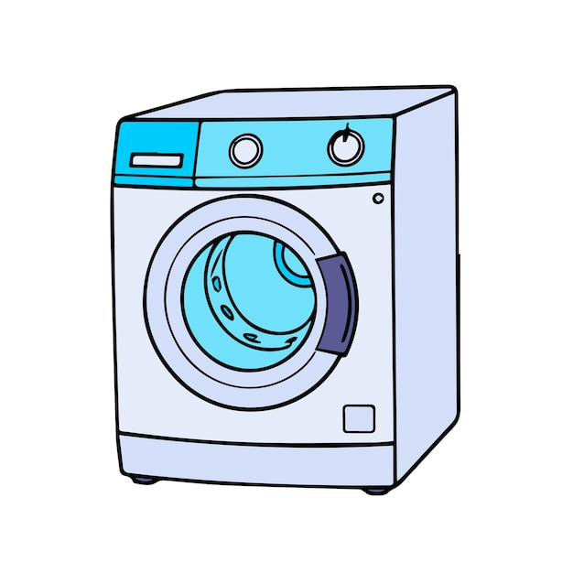
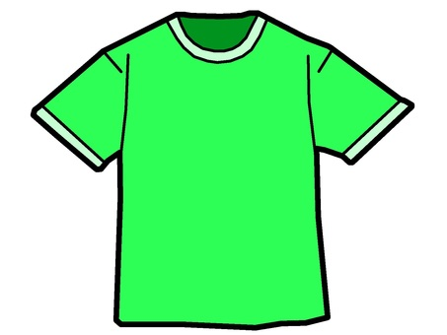
Functions
A function is code which you put data into (called parameters), and it gives back some different data (output):
dirty_clothes
wash(dirty_clothes)
clean_clothes
In this example, the function is called wash():
It takes clothes, and makes them clean

Slide 5
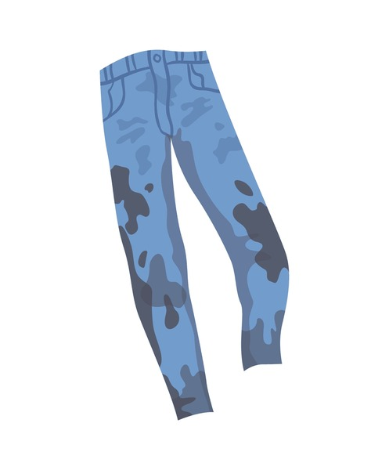
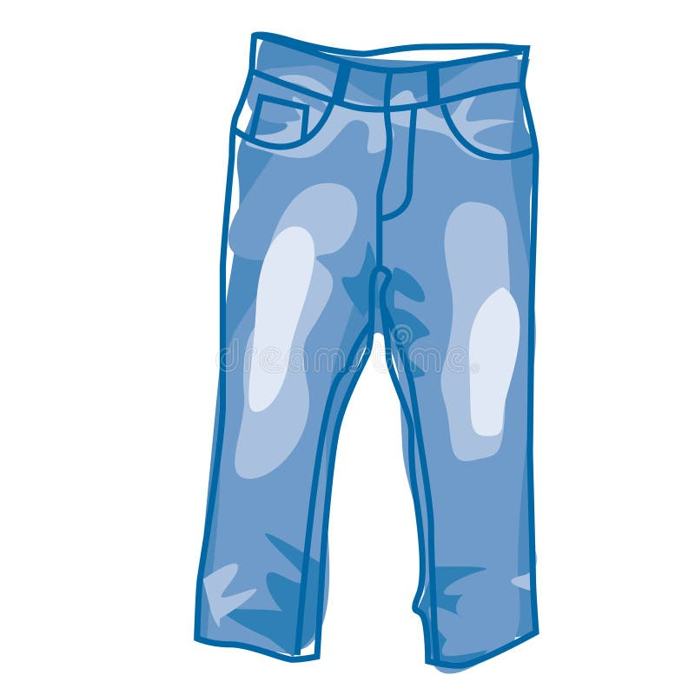


You can put different things (parameters) into a function, and it will return data based on what you put inside:
dirty_jeans
wash(dirty_jeans)
clean_jeans
dirty_socks
wash(dirty_socks)
clean_socks

Slide 6

Another Example
Imagine a machine which you put a number into, and how many decimal places you want to round it to.
3.14159
3.14
2 decimal places
12.3456789
12.345
3 decimal places

Slide 7

In Code
The following Visual Basic program rounds a real number to the nearest two decimal places:

Slide 8
The Round Function
Round has two “Parameters” - pieces of data you put between the brackets of a function:
The first piece of information is the number you want to round
The second piece of information is the number of decimal places you want to round the number to
The rounded number can be stored inside a variable
result = Math.Round( 3.14159 , 2 )
result = 3.14

Slide 9
Predefined Functions
A block of code already written and built into a programming language or software:
Like the Machine – you don’t have to make it, you just need to know how to use it
Designed to perform a specific common task without needing the programmer to make it from scratch
There are three you need to know in National 5:
Round
Length
Random

Slide 10
The Length Function
The Len() function calculates how many characters there are in a string.
Example:
  Dim my_word As String
  Dim word_length As Integer
  my_word = “MrWang4Eva”
  word_length = len(my_word)
word_length will have a value of 10

Slide 11
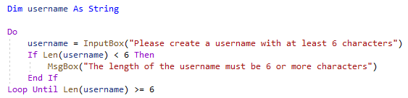
The Length Function
The example below asks the user to create a username that is 6 or more characters in length:
It will then check if this is true
IF NOT then it will provide an error message and then ask them to re-enter

Slide 12
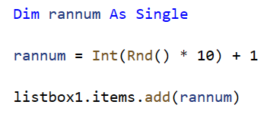
The Random Function
The Rnd() function generates a random number between 0-1:
The above program generates a number between 1 and 10
We also use the Int() function to convert the a real number to an integer
The formula to use is:
Variable = Int(RND() * Possibilities) + Lowest

Slide 13
Learning intentions and success criteria
I am learning…
I can…
About the 3 predefined functions in National 5
How to use predefined functions in Visual Basic
Describe the three predefined functions and what they are used for
Write programs using predefined functions

